Slide 1

Title: Hospital Resource Scheduling Management System
Student Name: G Boomika Sre
Student ID: 2520030010
Cluster: 2
Section: 6
Under the Guidance
of
Supervisor Name: N. M Deepika
Assistant Professor
Department of CSE

Slide 2
Abstract
The Hospital Resource Scheduling Management System is a web-based application developed to simplify patient appointment scheduling and hospital resource management. It provides an interactive dashboard that allows staff to manage patient bookings, assign doctors, monitor critical resources such as ICU beds and ventilators, and track hospital capacity in real time. The system is built using HTML, CSS, and JavaScript, ensuring a structured design and responsive user interface. By reducing manual effort and improving operational coordination, the application demonstrates how modern web technologies can efficiently support hospital management processes.

Slide 3
Existing System
Currently, many hospitals rely on:
• Manual appointment registers • Separate systems for scheduling and resource management • Phone-based booking systems • Delayed emergency handling • No real-time resource utilization tracking
Limitations:
• Time-consuming processes • Risk of human errors • Poor emergency response • No live hospital capacity monitoring

Slide 4
Proposed System
The proposed system is a web-based Hospital Resource Scheduling Management platform that digitizes appointment booking and hospital resource allocation.
It provides a centralized dashboard for hospital administrators to manage both standard and critical cases efficiently.
Key Features:
• Standard patient appointment scheduling • Emergency critical resource allocation • ICU bed management • Ventilator allocation • Real-time hospital analytics dashboard • Staff allocation based on departments

Slide 5
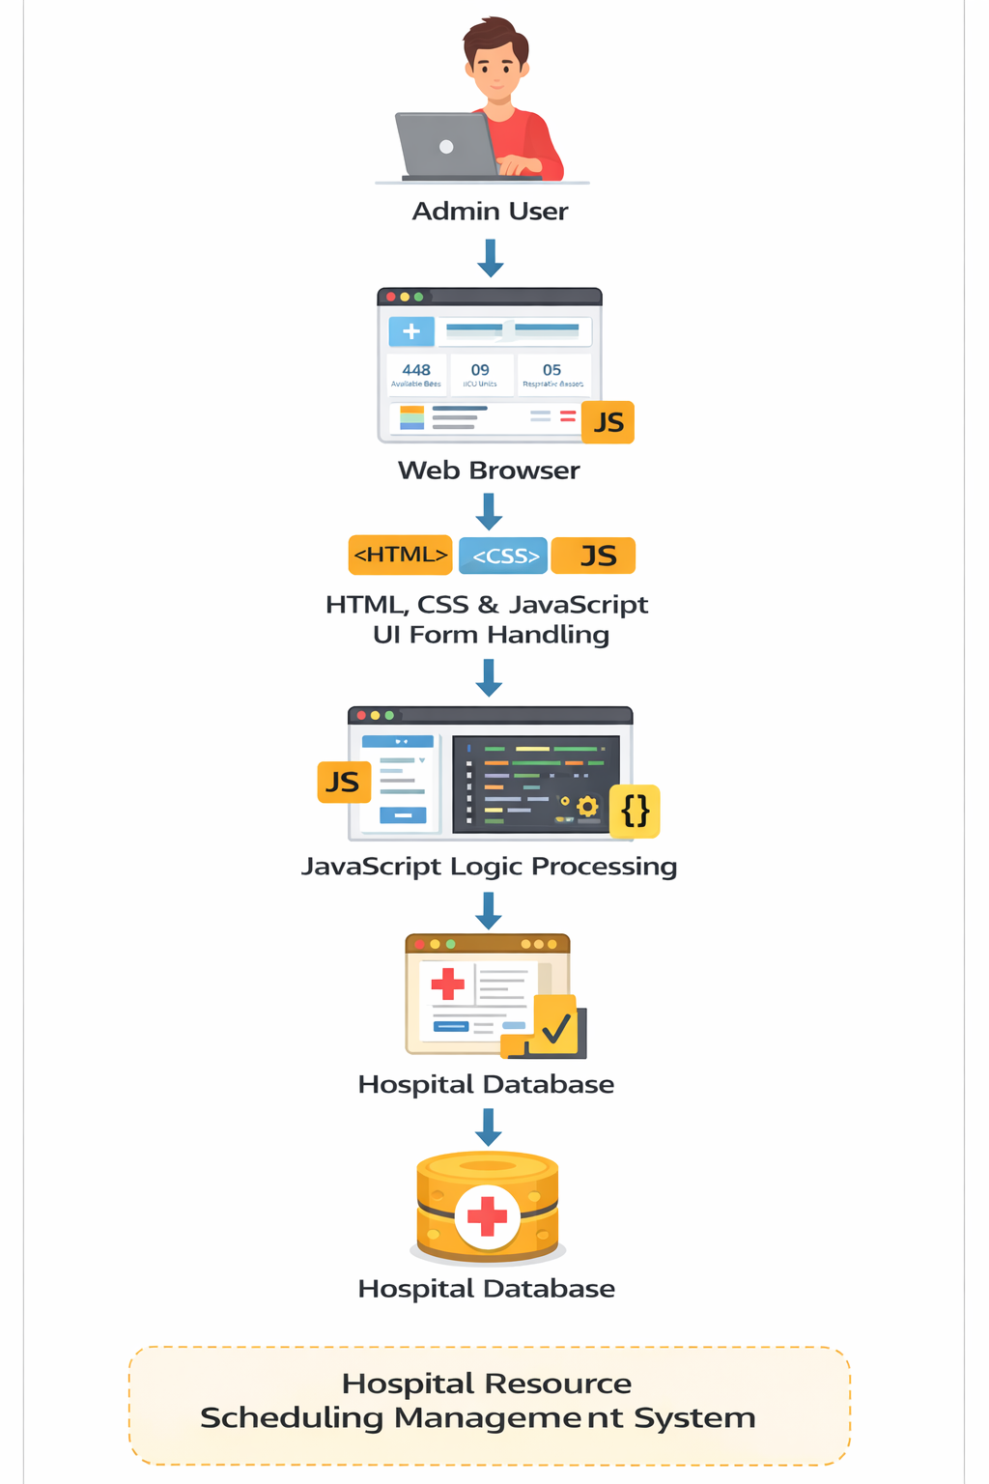
System Architecture

Slide 6
Project Modules
1️⃣ Login Module
• Secure staff login • Authentication interface
2️⃣ Standard Appointment Module
• Book patient appointments • Department selection • Staff assignment • Time slot scheduling

Slide 7
3️⃣ Emergency Resource Module
• Critical patient entry • ICU bed allocation • Ventilator allocation • Immediate resource deployment
4️⃣ Resource Monitoring Module
• ICU utilization tracking • Ventilator usage tracking • Bed availability monitoring • Real-time progress indicators

Slide 8
5️⃣ Patient Management Module
• Live patient list • Triage categorization • Release patient option

Slide 9
Objectives
• To digitize hospital appointment scheduling
• To manage hospital resources efficiently
• To reduce manual workload of hospital staff
• To provide a centralized dashboard for hospital operations

Slide 10
Co’s Attainments - FWD
CO1 – Web Fundamentals
Implemented web architecture and browser-based system.
CO2 – HTML Forms & Semantic Content
Designed forms for appointments and emergency cases.
CO3 – CSS Layouts & Styling
Created professional dashboard UI using modern layouts.

Slide 11
Co’s Attainments - FWD
CO4 – JavaScript Programming
Implemented logic for scheduling and calculations.
CO5 – JavaScript Interactivity & Deployment
Enabled real-time dashboard updates and resource tracking.

Slide 12
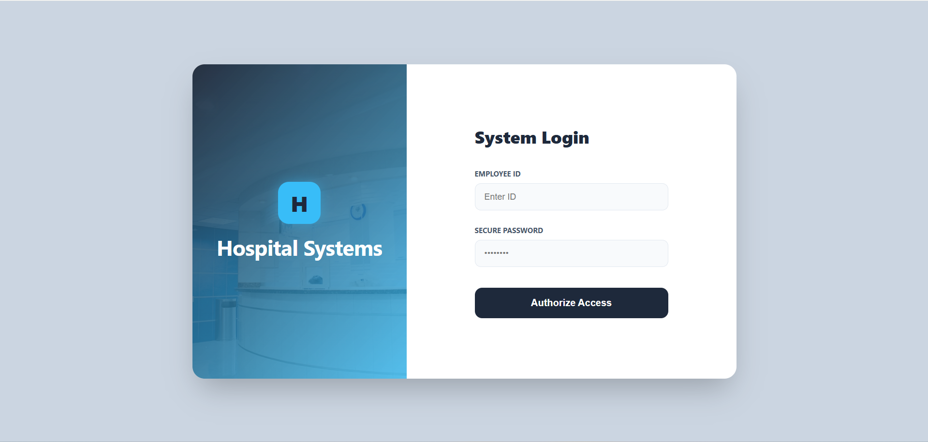
Screenshots for FWD

Slide 13
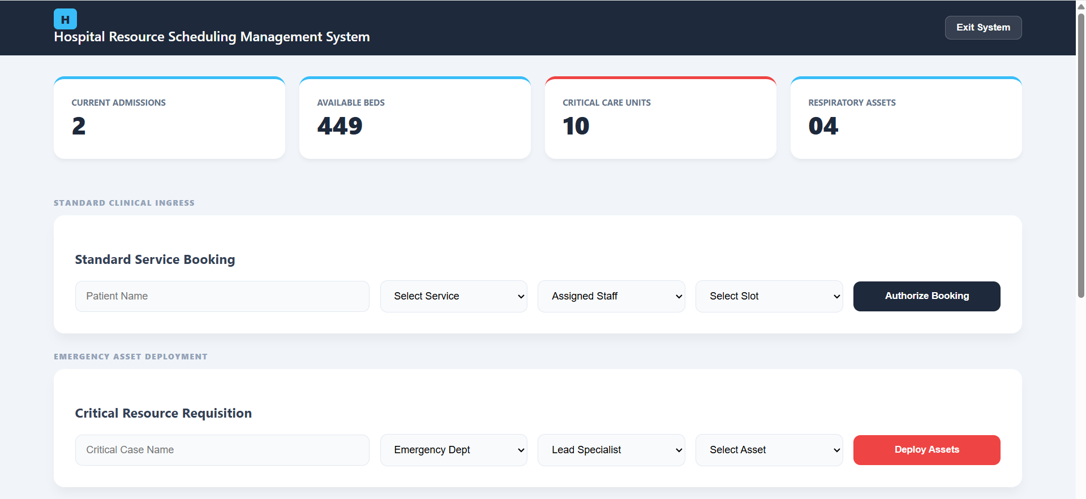

Slide 14
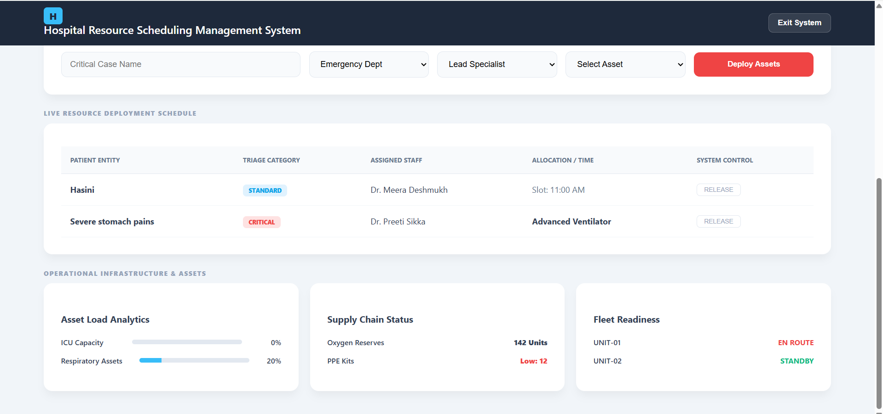

Slide 15
Conclusion
This project successfully developed a Hospital Resource Scheduling Management System using HTML, CSS, and JavaScript that streamlines patient appointment booking, emergency resource allocation, and real-time monitoring of hospital resources. The system improves operational efficiency by reducing manual workload and providing a centralized dashboard for managing hospital activities, demonstrating how web technologies can effectively address real-world healthcare management needs.

Slide 16
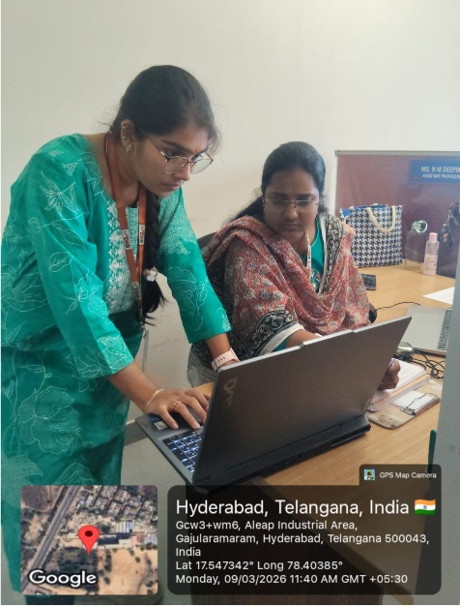
Geo- Tag Photos

Slide 17
THANK YOU

